Slide 1
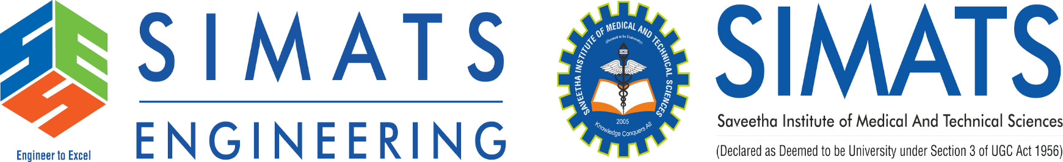
Adaptive Employment Readiness Platform Using Real-Time Industry Skill Demand Mapping
CSA0925- Programming in Java
Guided By :Dr. Sivasankar C
Department:CSE
Presented By:
PAPINENI SISINDRI(192324122)
Nithish Raaju V
Pavithran M

Slide 2


Problem Background
Application Domain
The project belongs to the fields of Artificial Intelligence, Career Analytics, and Education Technology (EdTech).
It helps students understand industry trends and develop job-ready skills through data-driven insights.
Current Scenario
Many graduates possess academic knowledge but lack the practical skills expected by employers.
Rapid changes in technology make it difficult for students to keep track of current industry requirements.
Need for the Project
Students need a platform that provides real-time information about trending skills and job market demands.
Personalized guidance can help users focus on the right skills and improve employability.
Target Users
Undergraduate students, fresh graduates, and job seekers preparing for careers in various industries.
Colleges and training institutions can also use the platform to improve student readiness.

Slide 3
Problem Statement
Problem Definition
Students often lack awareness of the latest industry-required skills and technologies.
There is a mismatch between academic learning and employer expectations.
Career decisions are frequently made without real-time market insights.
Limitations of Current Systems
Existing platforms provide static and generic career recommendations.
Most systems do not track real-time industry skill demand.
Personalized skill-gap analysis and learning guidance are limited.
Expected Impact
Help students identify and develop industry-relevant skills.
Improve employment readiness through personalized recommendations.
Increase placement opportunities and career success rates.

Slide 4
Objectives
Primary Objective
To develop an intelligent platform that maps industry skill demand and evaluates employment readiness.
To provide personalized recommendations that help users become job-ready.
Specific Objectives
Analyze job market data and identify the most in-demand skills across industries.
Compare user skills with industry requirements and identify missing competencies.
Project Scope
Focuses on students, fresh graduates, and entry-level job seekers seeking career guidance.
Covers skill analysis, learning recommendations, and employment readiness assessment.

Slide 5
Literature Review
Year | Author | Key Focus / Findings
2025 | Sharma et al. | Developed an AI-based career recommendation system that suggests suitable job roles based on user skills and educational background.
2024 | Kumar & Singh | Proposed a machine learning framework for skill-gap analysis by comparing candidate profiles with industry requirements.
2024 | Chen et al. | Applied NLP techniques to analyze job postings and identify trending skills across multiple industries.
2023 | Patel & Roy | Designed a personalized learning recommendation system that suggests courses based on user interests and career goals.
2025 | Johnson et al. | Developed a real-time employment readiness assessment platform that evaluates candidate skills and provides improvement recommendations

Slide 6
Existing Vs Proposed
Existing System | Proposed System
Provides generic career guidance based on predefined rules and static information. | Provides personalized career guidance based on user skills, interests, and industry requirements.
Does not analyze real-time job market trends and changing skill demands. | Continuously tracks and analyzes real-time industry skill demand from job portals and career websites.
Limited or no skill-gap identification between user skills and industry expectations. | Performs detailed skill-gap analysis and identifies missing or weak skills.
Offers fixed learning recommendations that do not adapt to user progress. | Generates adaptive learning paths that update based on skill gaps and learning progress.
Focuses only on career recommendations without employability assessment. | Calculates employment readiness scores and provides improvement strategies.
Separate platforms are needed for career guidance, learning, and skill assessment. | Integrates skill analysis, learning recommendations, and readiness assessment into one platform.

Slide 7
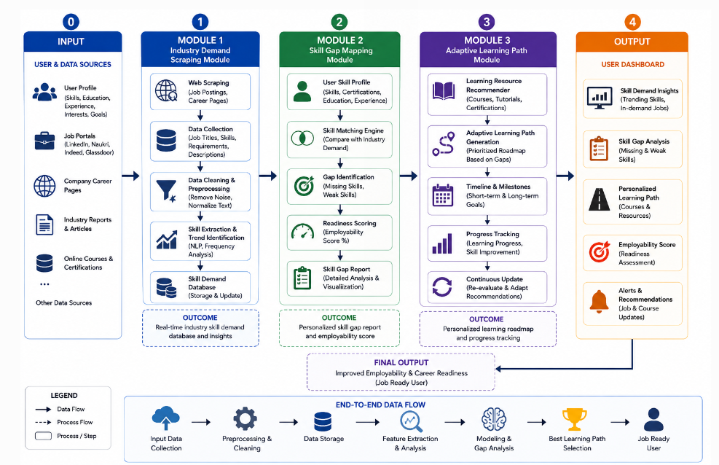
System Architecture

Slide 8
Module 1: Industry Demand Scraping Module
Collects job postings from platforms such as LinkedIn, Naukri, Indeed, and company career pages to gather current market requirements.
Extracts important information including job titles, required skills, qualifications, experience levels, and job descriptions.
Cleans and preprocesses collected data by removing duplicates, irrelevant content, and formatting inconsistencies.
Uses Natural Language Processing (NLP) and text analysis techniques to identify trending skills and technologies.
Stores and updates skill-demand information in a centralized database for further analysis and recommendations.

Slide 9
Module 1: Output

Slide 10
Module 2: Skill Gap Mapping Module
Collects user profile details such as education, technical skills, certifications, projects, and career interests.
Compares the user's existing skills with current industry-required skills obtained from Module 1.
Identifies missing, weak, and outdated skills that may affect employability and career growth.
Calculates a skill-match percentage and employment readiness score based on industry standards.
Generates a detailed skill-gap report highlighting strengths, weaknesses, and areas for improvement

Slide 11
Module 2: Output

Slide 12
Module 3: Adaptive Learning Path Module
Analyzes the skill-gap report and prioritizes skills based on industry demand and career goals.
Recommends relevant courses, certifications, tutorials, and learning resources for skill development.
Creates a personalized learning roadmap with short-term and long-term learning milestones.
Tracks user progress and continuously updates recommendations based on completed learning activities.
Provides adaptive career guidance to help users achieve better employability and job readiness outcomes.

Slide 13
Module 3: Output

Slide 14
Results and Insights

Slide 15
Planning
Conduct literature survey and analyze existing career guidance and skill assessment systems.
Design system architecture, database structure, and user interface for the platform.
Develop industry demand scraping, skill gap mapping, and adaptive learning modules.
Test system performance, recommendation accuracy, and user experience.
Deploy the platform and validate results using real-world job market data.
Prepare project documentation, reports, and final presentation materials.

Slide 16
Expected Outcomes
Analyze real-time industry skill demand and identify trending technologies.
Detect skill gaps by comparing user profiles with industry requirements.
Generate personalized learning paths and certification recommendations.
Provide employment readiness scores and career improvement suggestions.
Improve employability through continuous skill development and monitoring.
Support students in making informed career decisions based on market trends.

Slide 17
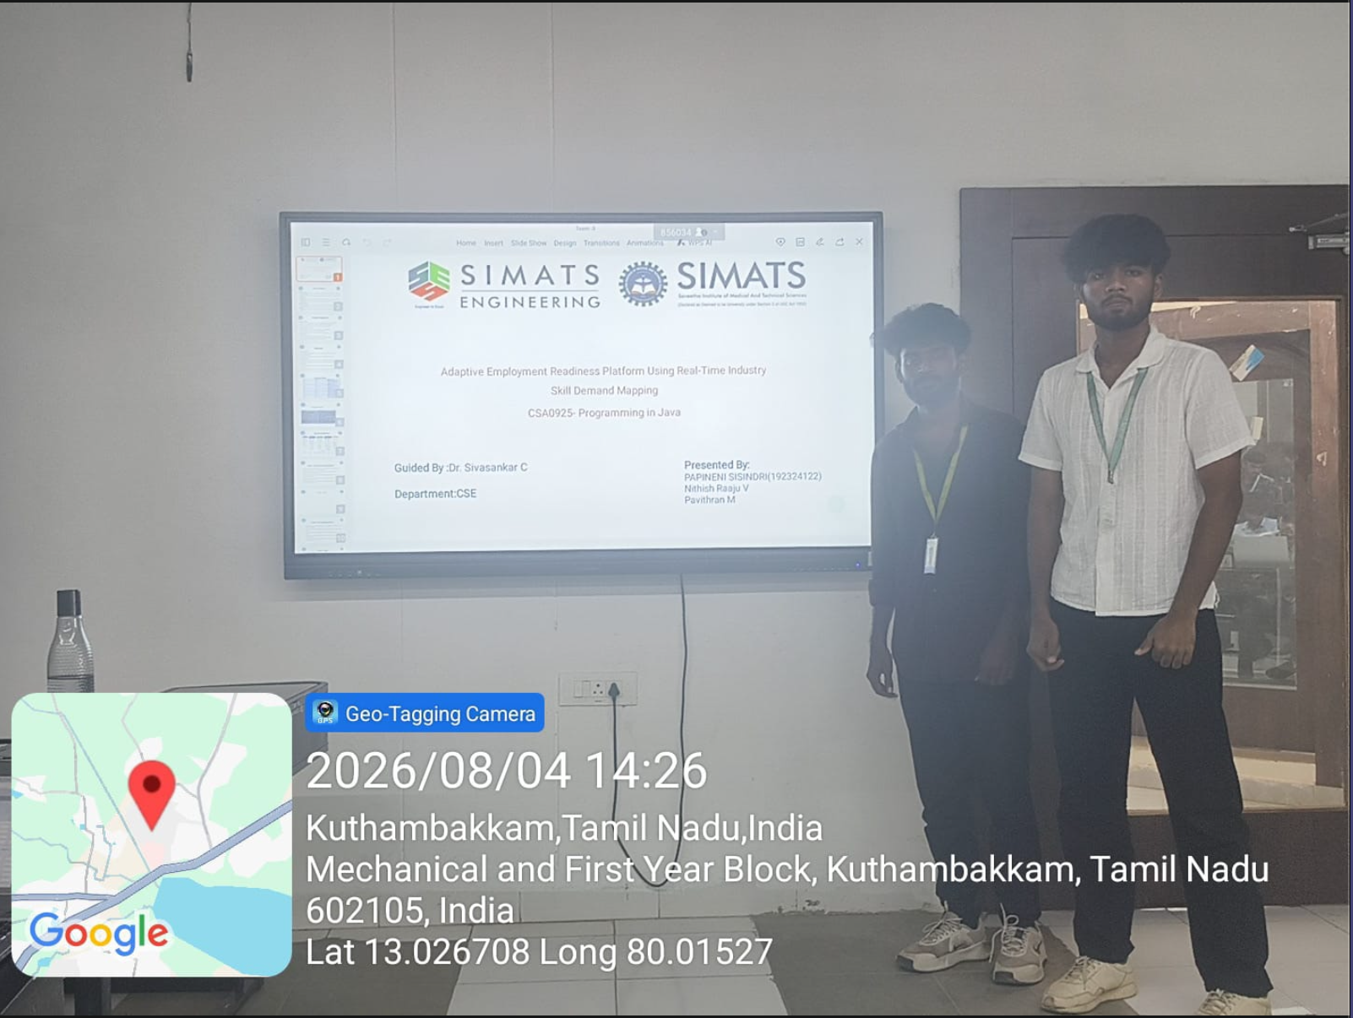

Slide 18
Thank You

